Slide 1
Water Soluble Vitamins & Minerals
Dr. Reshma Reghu

Slide 3
THIAMINE (B1)

Slide 8
RECOMMENDED ALOWANCE
30 mg
> lost in urine
Patient with regular dialysis need thiamine supplementation

Slide 9
RIBOFLAVIN (B2)

Slide 10
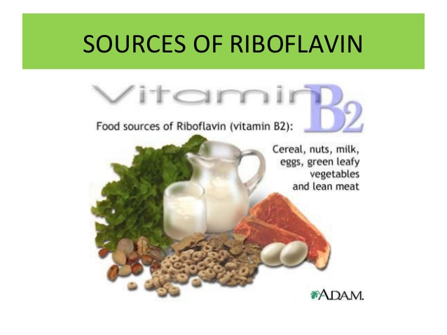
Germination increases the content in pulses & cereals

Slide 12
REQUIREMENT
Daily requirement is 0.6 mg/ 1000 kcal of energy intake.
No real body stores.

Slide 13
NIACIN (B3)
Tryptophan serves as its precursor
Action on Epithelial cells

Slide 14
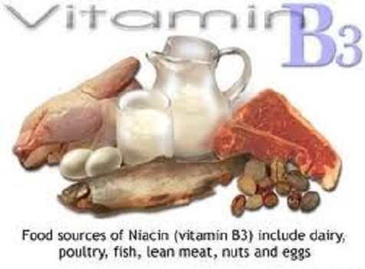
Milk is a poor source of Niacin but rich in tryptophan

Slide 16
PREVENTION:
Good mixed diet containing milk and meat.
Avoid total dependence on maize
Pellagra is a poverty disease
Steps to improve economic, agriculture and social development
REQUIREMENT:
Daily allowance- 6 mg/1000 kcal of energy intake

Slide 17
PYRIDOXINE (B6)

Slide 19
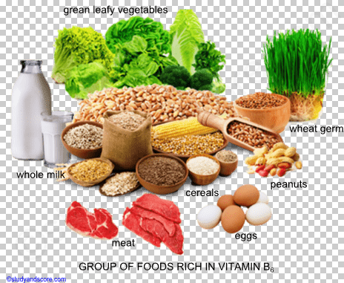

Slide 21
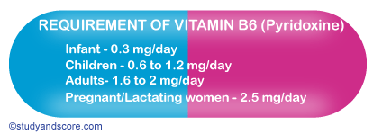

Slide 22
PANTOTHENIC ACID (B5)
Related to Adrenal Cortical function.
Biosynthesis of corticosteroids
Human blood normally contains 18 to 35 mg of pantothenic acid per 100 ml.
Act as co enzyme
Daily requirement is 10 mg
All food contribute to dietary intake

Slide 23
FOLATE
Folacin & folic acid
Occurs in 2 forms- free folate & bound folate
Free folate is absorbed from the proximal part of small intestine
Main role in synthesis of nucleic acids.
Also normal development of blood cells in marrow

Slide 25
DEFICIENCY:
From poor diet
Increased requirement in pregnancy & Lactation.
Megaloblastic anemia
Glossitis
Cheilosis
GIT Disturbances viz; diarrhoea, distention, & Flatulence
Severe form, Infertility & sterility
Laboratory assessment based on measurement of serum and red cell folate concentrations, by microbiological assay

Slide 26
Intake values recommended by ICMR (2010)
Requirements per day
Healthy Adults- 200 mcg
Pregnancy – 500 mcg
Lactation- 300 mcg
Children – 80 to 120 mcg

Slide 28
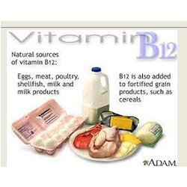

Slide 29
DEFICIENCY
Megaloblastic anemia
Demyelinatind neurological lesions in spinal cord
Infertility
REQUIREMENT
Intake values recommended by ICMR (2010)
Requirements per day
Normal adults: 1 mcg
Pregnancy: 1.2 mcg
Lactation : 1.5 mcg
Infants & Children : 0.2 mcg

Slide 31
REQUIREMENT: 40 mg per day for adults

Slide 32
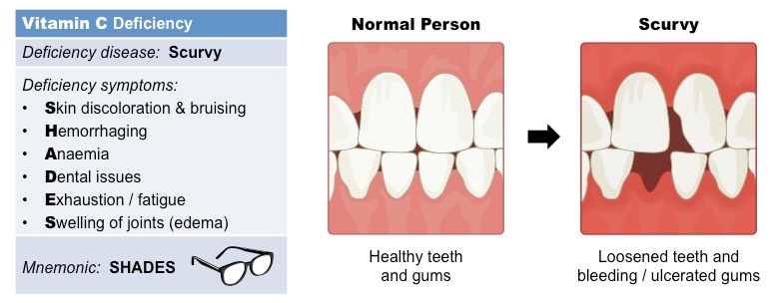

Slide 34
CALCIUM
Major mineral element in our body
1.5 to 2 % of body weight of an adult human
Average adult contains 1200 mg of calcium of which 98% in bones.
The amount of calcium in the blood is 10 mg/dl
Developing foetus require 30 g of calcium
A dynamic equilibrium of calcium in blood & skeleton is maintained by the interaction of Vitamin D, parathyroid hormone and calcitonin.

Slide 38
Deficiency:
No clear cut disease due to calcium deficiency.
Requirement:
Daily intake of 600 mg of calcium has been suggested for adults.
Physiological requirement is higher in children.

Slide 39
PHOSPHORUS
Essential for formation of bones & teeth
Important part in all metabolism
Human body contains 400- 700 g of phosphorus as phosphates, mostly in bones and teeth.
Present in vegetable food in combination with phytin.

Slide 40
SODIUM
found in all body fluids.
Adult human body contains 100 g of sodium ion.
Sodium losses through sweat and urine
Depletion of sodium chloride causes muscle cramps.
Adult requirement is 5 g per day
Intake of > 10 g of salt per day have tendency to increase the blood pressure.

Slide 41
POTASSIUM
Adult human body contains 250 g of potassium.
Vasoactive, increases the blood flow and sustains metabolic need of the tissue.
Released by the endothelial tissues.
The ideal desirable sodium : potassium ratio is 1:1 (in mmol)

Slide 42
MAGNESIUM
Important constituent of bone.
Human adult body contains 25 g of magnesium, of which half is found in skeleton.
Essential for normal metabolism of calcium and phosphorus.
Deficiency is seen in Chronic alcoholics, Cirrhosis of liver, Toxaemias of pregnancy, PEM, Malabsorption syndromes.
C/F : Irritability, Tetany, Hyper-reflexia.
Requirements for adult- 340 mg/ day.

Slide 43
IRON
Adult human contains 3 to 4 g of iron
60 % - circulating blood
1 to 1.5 g- storage iron
Each gram of Hb contain 3.34 mg of iron

Slide 44
Functions
Formation of Hb
Brain Development & function
Regulation of Body temperature
Muscle activity
Catecholamine metabolism
Immune system
Oxygen transport & cell respiration

Slide 45
SOURCES
Haem – iron:
Liver, meat, poultry & fish
Non- haem iron
Vegetable origin
Food which inhibit the absorption of iron are Milk, Egg, Tea

Slide 46
ABSORPTION
From duodenum & Upper small intestine in ferrous state
Then transported as plasma ferritin
Stored in liver, spleen, bone marrow & kidney
Liberated iron is reutilized in the formation new red cells.

Slide 47
IRON LOSS
Total daily iron loss of an adult- 1 mg & 12.5 mg/ 28 days cycle in menstruating women.
Major routes of iron loss
Haemorrhage
Basal losses

Slide 48
IRON DEFICIENCY
With other detectable abnormalities
Latent Iron deficiency
Decrease in the concentration of circulating Haemoglobin

Slide 49
Cut Off Points forDiagnosis of Anemia

Slide 50
Evaluation of Iron Status
Haemoglobin Concentration
Serum iron concentration
Serum ferritin
Serum transferrin saturation

Slide 51
Iron Requirements

Slide 52
IODINE
Synthesis of thyroid hormones T4 & T3
Adult human contains 50 mg of iodine
Blood level is about 8 to 12 mcg/dl

Slide 53
SOURCES
Sea food & Cod liver oil
Other foods- milk, meat, vegetable & cereals.
Iodine content of fresh water is 1- 5 mcg/ L

Slide 54
GOITROGENS
Chemical substances leading to development of goitre.
Interfere with iodine utilization by thyroid glands
Mainly brassica group of vegetables. Probably cyanoglycosides & thiocyanates.

Slide 56
OTHER TRACE ELEMENTS
ZINC
COPPER
COBALT
CHROMIUM
SELENIUM
MOLYBDEDUM

Slide 57
DIETARY ANTI OXIDANTS

